Slide 1
HATE SPEECH ANALYSIS
TWITTER
Mahederemariam Dagne
Napoleon Davis II

Slide 2
Introduction
Team Members
Mahederemariam Dagne
Data Scientist
Napoleon Davis II
Data Scientist

Slide 3
About Dataset
COLUMNS AND ROWS
CLASSIFICATION
2020 Twitter Dataset
7 Columns
24784 Rows
Hate speech
Offensive
Neutral
https://www.kaggle.com/datasets/mrmorj/hate-speech-and-offensive-language-dataset?datasetId=723100&sortBy=dateRun&tab=bookmarked
Notes:
Dataset using Twitter data, is used to research hate-speech detection. The classifiers utilized in the original dataset hate speech, offensive, and neither. Note: Due to the nature of the study, we wanted prompt the audience that this dataset contains text that can be considered to be vulgar, racist, sexist, homophobic, and/or generally offensive.
24784 Tweets

Slide 4
Overview
This study focused on analyzing hate speech obtained from a 2020 Twitter dataset.
Data Extraction, Cleaning, and Transformation
Data Model Implementation and Optimization
Future Considerations

Slide 5
Extraction, Transforming, Loading
Cleaning
Removed usernames
Removed retweet tags
Removed punctuation
Removed indexed column
Notes:
Deleted index columns.
Added cleaned / tokenized tweets
Tokenization didn’t remove the usernames and retweet tags.
Used regular expressions to remove the usernames and RT tags

Slide 6
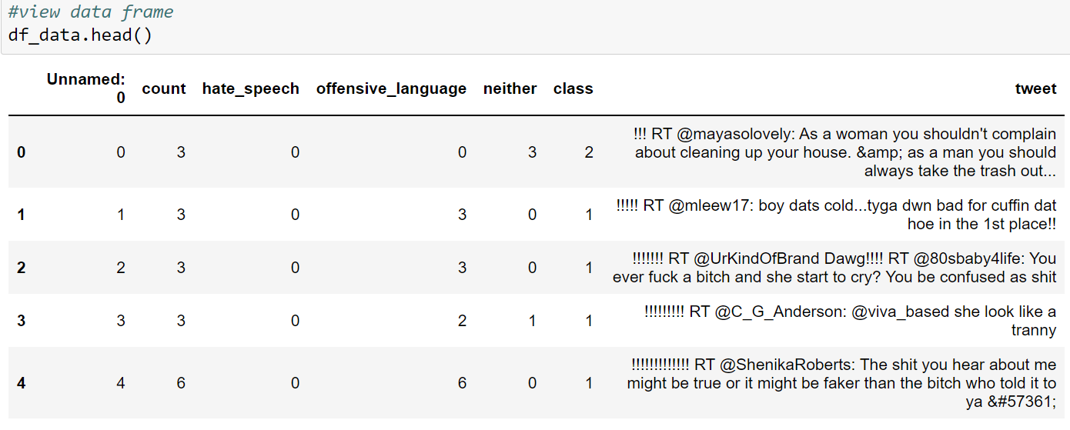
Extraction, Transforming, Loading (before)

Slide 7
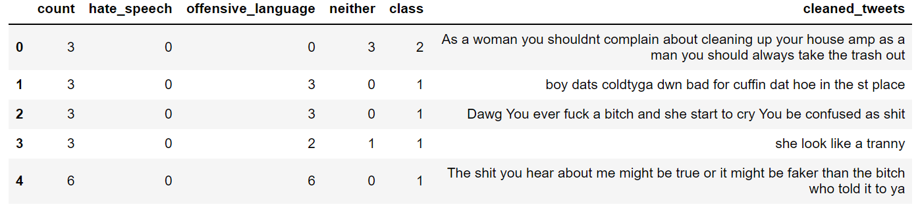
Extraction, Transforming, Loading (after)

Slide 8
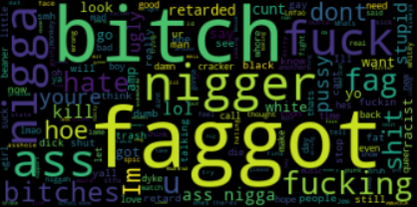
Hate

Slide 9
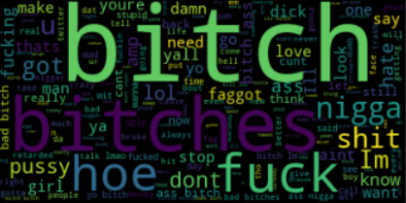
Offensive

Slide 10
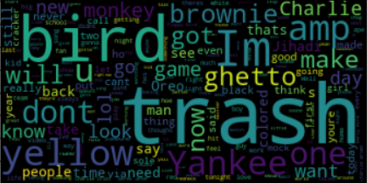
Neither

Slide 11
Data Modeling
Trained and Evaluated Data Model
Naïve Bayes Algorithm
Evaluated individual words
Evaluated phrases with n-grams

Slide 12
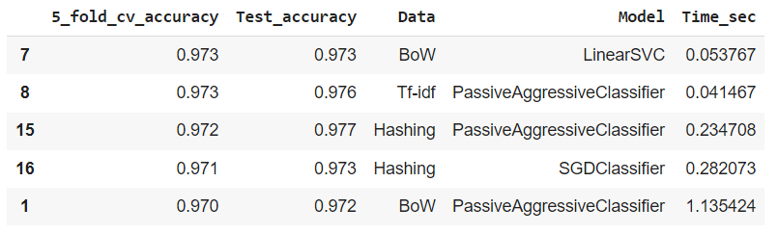
Classification model with stop words

Slide 13
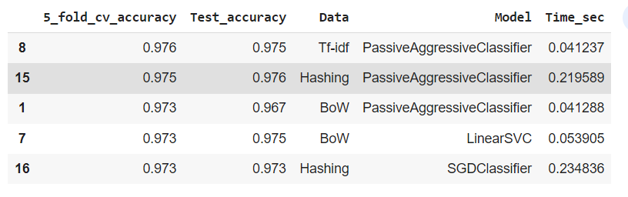
Classification model without stop words

Slide 14
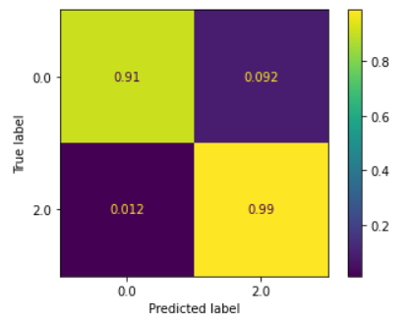
Accuracy for Negative and hate Speech

Slide 15
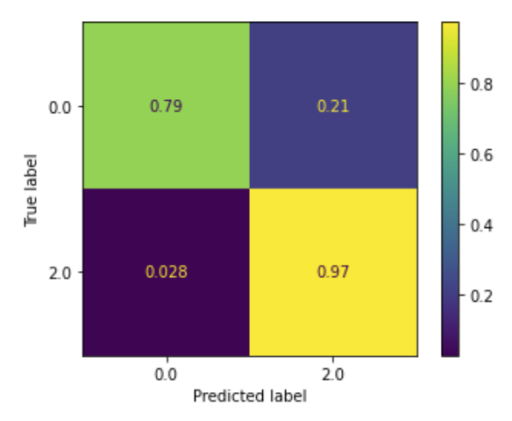
Confusion Matrix for Original data frame

Slide 16
Conclusion
Best Classification model: Passive aggressive classifier with tfidf vectorizer
Without stop words performed better than with stop words

Slide 17
Problems Encountered
Problems and Limitations
Deciding on the best classification model
Methodology in which we approached solution
Time constraints prevented us from further optimization

Slide 18
Future Considerations
Incorporate twitter API to obtain updated dataset
Pull annual dataset from twitter to analyze hate speech over time
Evaluate using trained model.
Incorporate Multi-label classification model

Slide 19
Thank you
Mahederemariam Dagne
Github: https://github.com/MahiLu
Napoleon Davis II
Git hub: https://github.com/leo-the-virgo

